Slide 1


SlicerWMA User Guide
Kening Zhang

Slide 2
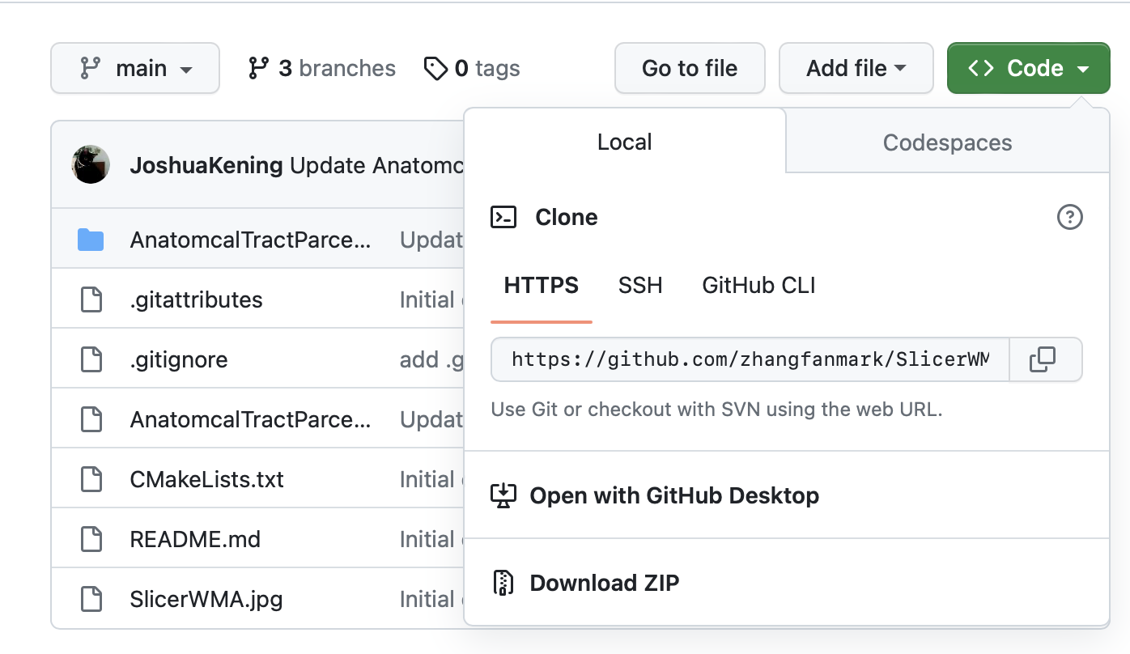
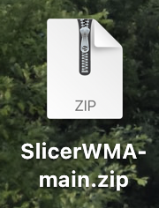
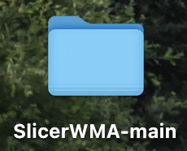
Two ways for loading WMA in Slicer
Method 1:
Download the compressed package from Github and load it locally
Web address: https://github.com/zhangfanmark/SlicerWMA
Click ”Code” and then “Download ZIP”
Unzip

Slide 3
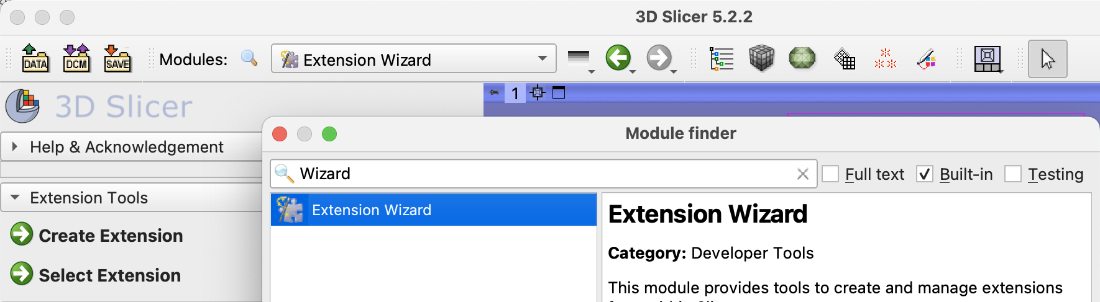

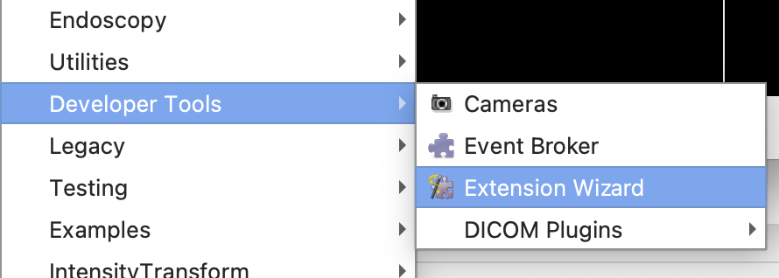
Open Extension Wizard
Click the icon and type “Wizard” to open
Or:
Open the drop-down box, find “Extension Wizard” in “Developer Tools”

Slide 4
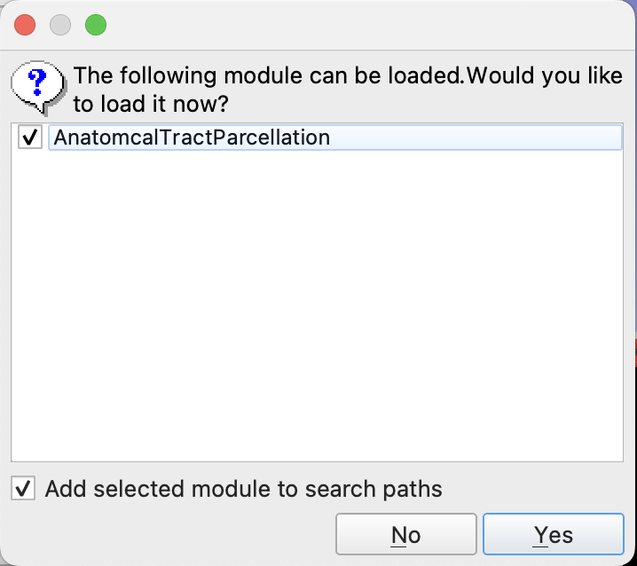
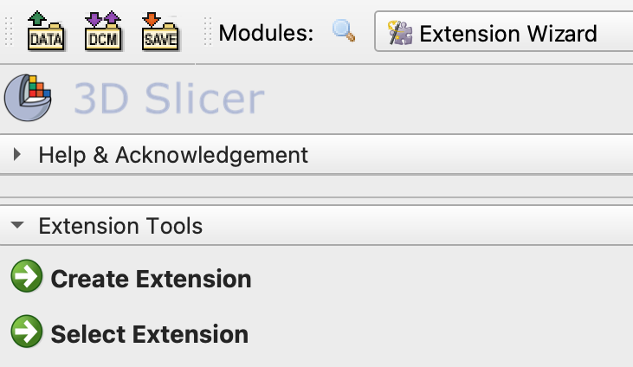
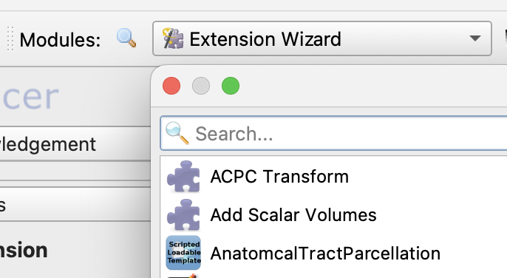
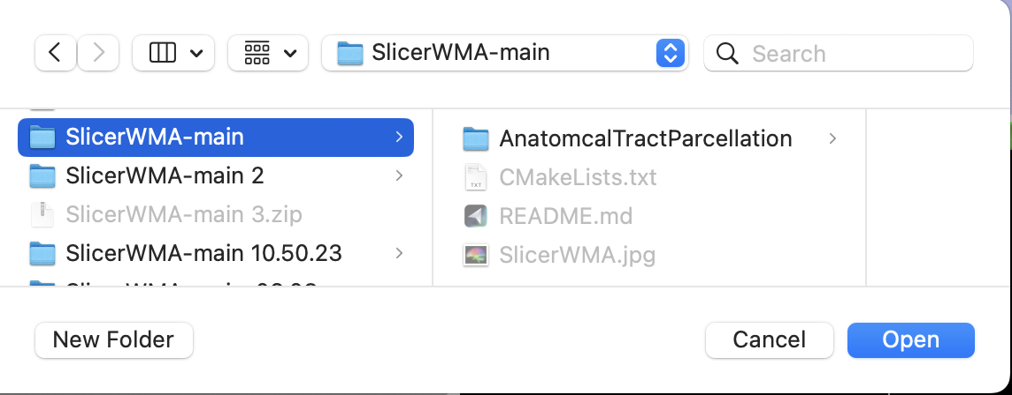
Switch to “Extension Wizard”
Click “Select Extension” and choose the folder
“AnatomcalTractParcellation” can be found in “Modules” now!

Slide 5
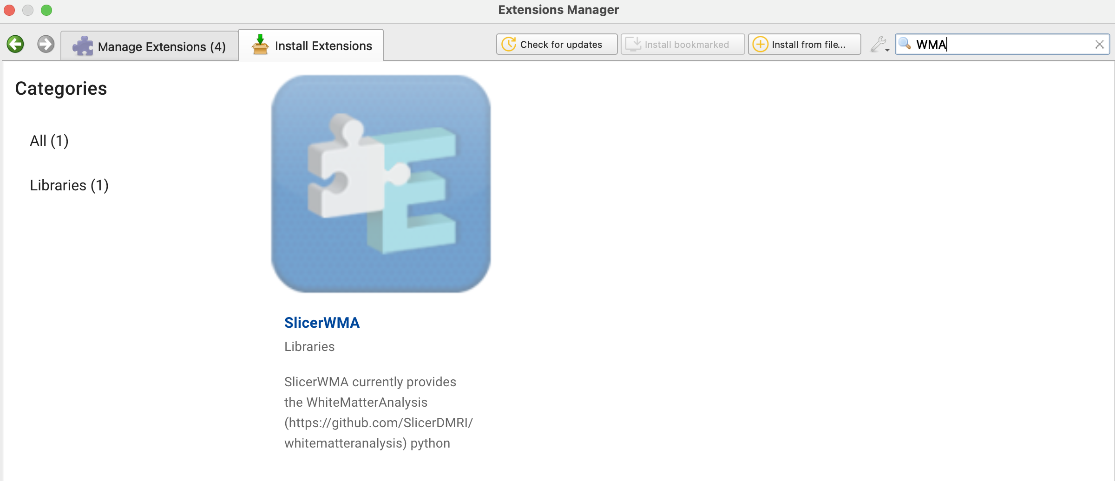
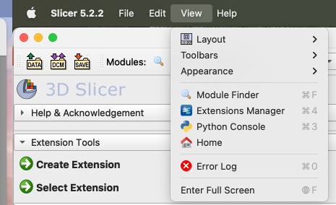
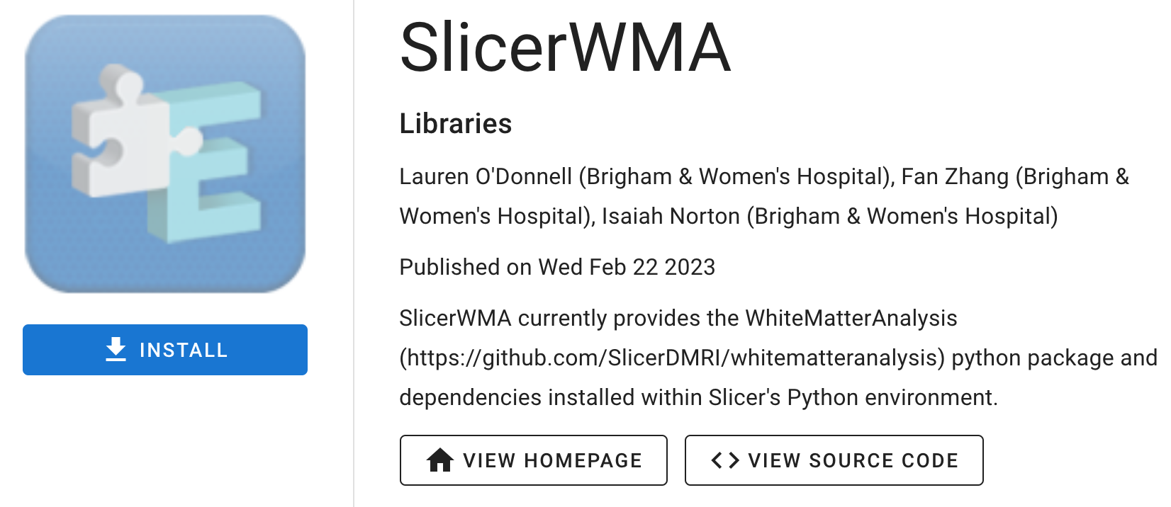
Method 2:
Open “Extensions Manager”
Search “WMA” in “Install Extensions”
Find “SlicerWMA” and install it
“WMAScriptedModule” can be found in “Modules” now!

Slide 6
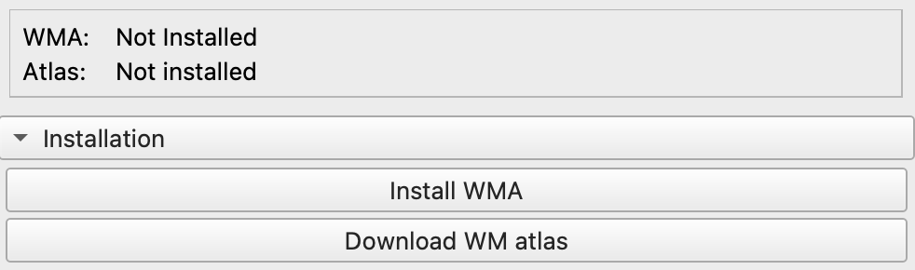
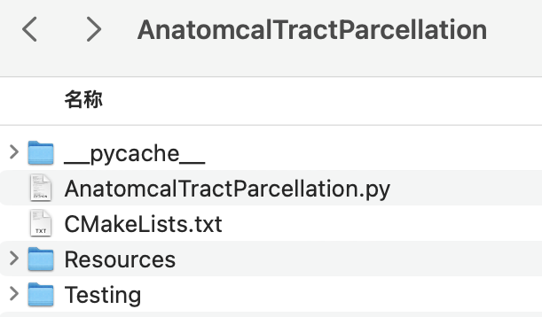
Initial installations
Whitematteranalysis relies on two requirements, where their status are shown in message box:
Click these buttons for installation
Notice: Due to the size of WM atlas, download may fail in Slicer. If happens, download the atlas in:
Chinese user:
https://pan.baidu.com/s/1GLsxUvWA2rqjd5l5wWghaw?pwd=WMA1 Code: WMA1
Others:
https://www.dropbox.com/scl/fi/luwohdaaxksnl1hexhvgg/ORG-Atlases-1.1.1.zip?rlkey=nxxy2osngbpwuzd5w51dd4qo2&dl=0
Then place the atlas to “Resources”

Slide 7
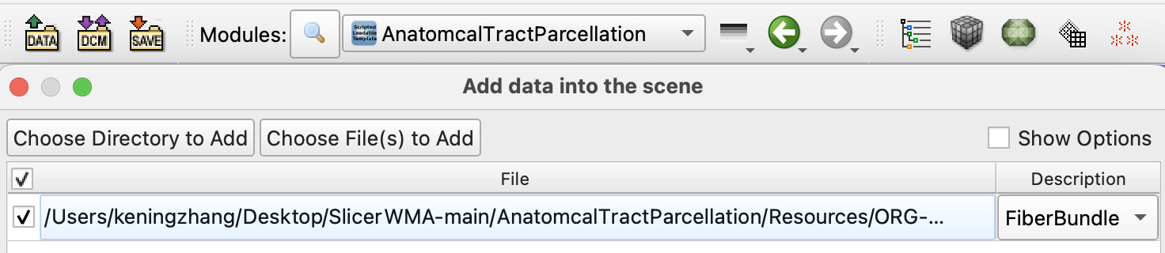
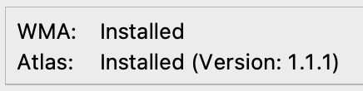
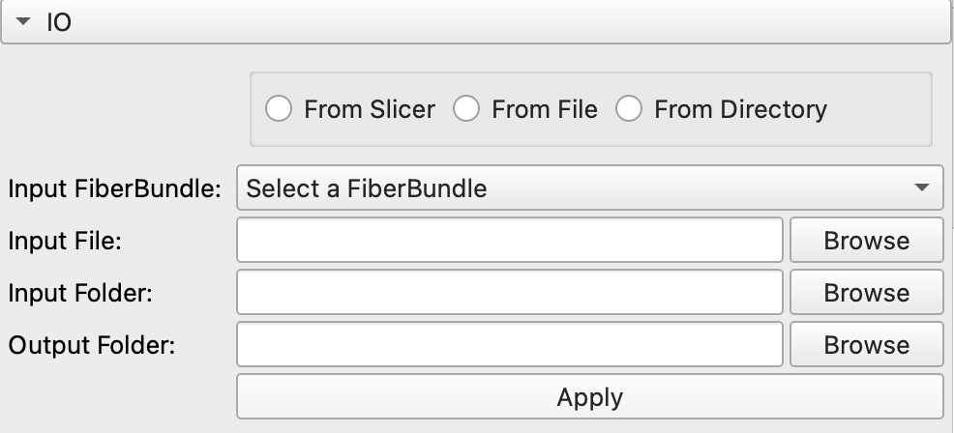
Input & Output setting
Move to this phase when both WMA and Atlas are installed !
Decide the source of the input (Choose one of three ways)
From Slicer: Use FiberBundle in Slicer scene as input
Choose in “Input FiberBundle”
From File: Choose a single file in local disk as input
Browse and choose in “Input File”
From Directory: Iterate through the selected folder, taking all “.vtp” and “.vtk” files as input
Browse and choose in “Input Folder”
Select the output folder which all results will store in
Notice: The path name supports only letters, numbers, and symbols.

Slide 8
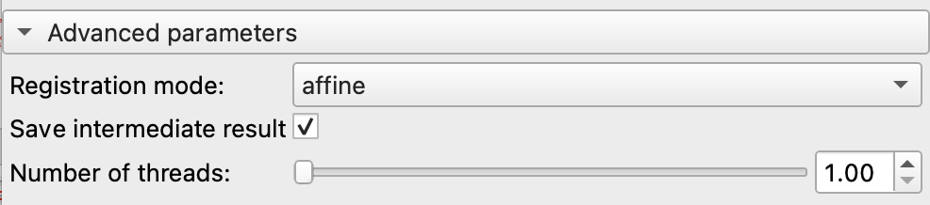
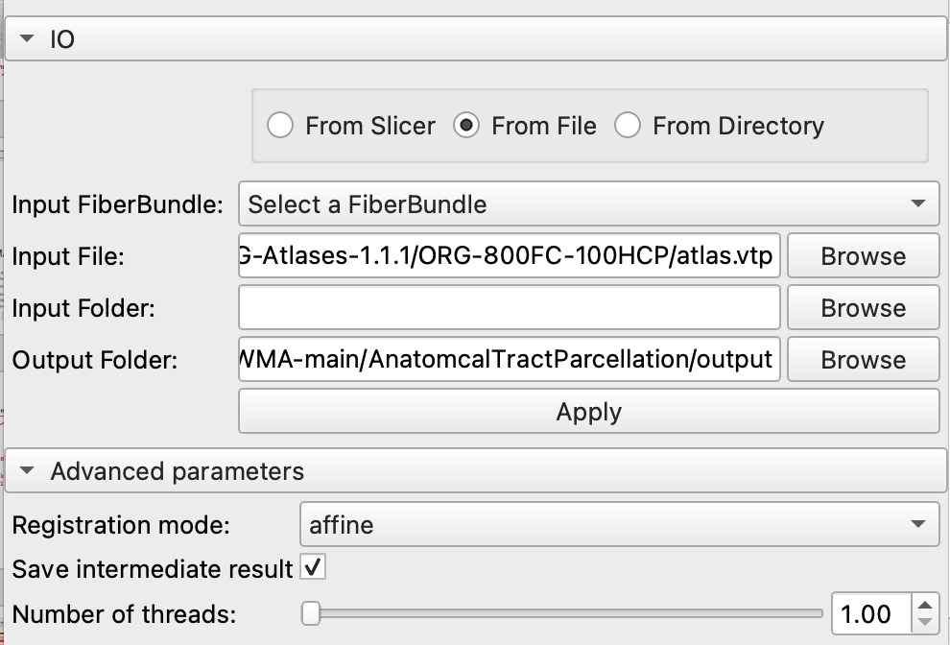
Advanced parameters setting
Two modes offered: affine
& affine + nonlinear
Clear unnecessary intermediate results based on selection
Default setting
Drag to select the number of processors, integers from 1 to 8
Execute the program
Once all Settings have been determined, click the “Apply” button to execute the program

Slide 9
Execute the program
Once all Settings have been determined, click the “Apply” button to execute the program

Slide 10
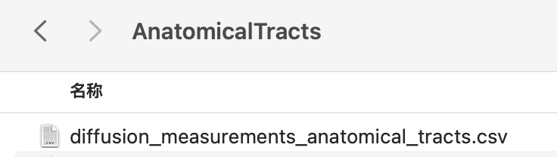
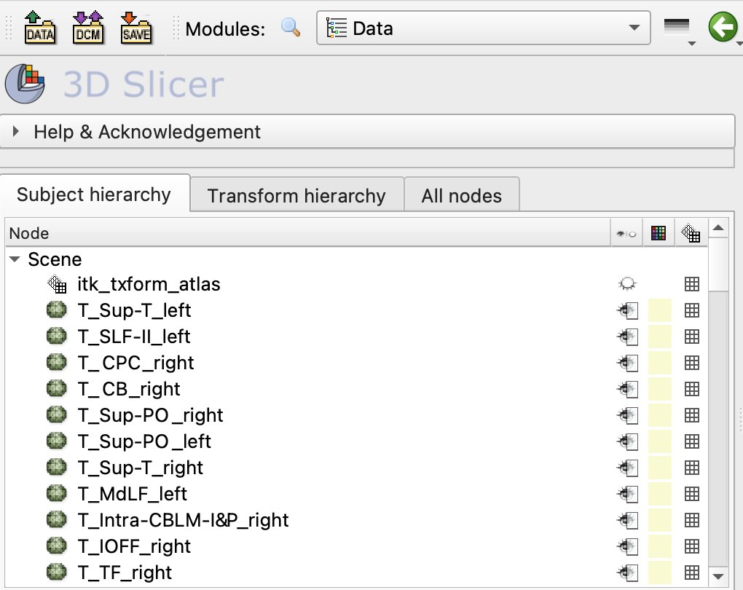
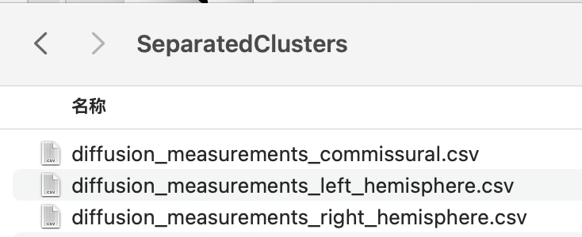
Output
csv files are generated in “AnatomicalTracts” and “SepareatedClusters”
Generated anatomical tracts are loaded in Slicer scene

